Slide 1
ENGR. MUHAMMAD OSAMA
MECHANICAL ENGINEER
CAD DESIGNER
PORTFOLIO

Slide 2
ABOUT ME
2+ Years of experience as a Mechanical Engineer - specializing in full product development lifecycle, from concept to production.
3+ Years of experience as CAD designer using multiple software especially SolidWorks– part, assemblies or sub-assemblies design, ensuring precision and efficiency.
Proven ability to work and manage tasks independently including hands-on tasks.
Expertise in Design for Manufacturing and Assembly (DFMA), prototyping and 3D printing for optimized production processes.
Skilled in generating BOMs, 2D drawings and technical documentation, supporting seamless project execution.
Strong cross-functional collaboration, working effectively with diverse teams to achieve project goals.
Experienced in working fast-paced + high level of ambiguity in dynamic start-up environment in short deadlines.
Proven ability to deliver multiple customized successful projects.

Slide 3
PORTFOLIO STATEMENT
This portfolio demonstrates a broad range of design and engineering skills that extend beyond UAV projects. It includes expertise in part design, large-scale assembly development, and system integration, with a focus on manufacturability, precision, and compliance with engineering standards. The work reflects proficiency in CAD modeling, prototyping, and technical documentation, showcasing the ability to deliver innovative, production-ready solutions across diverse mechanical and product design applications.

Slide 4
PROJECTS COMPLETED
Loiter Munitions UAVs
- Designed, drafted CAD including installation planning of components, and fabricated UAVs specialized for loitering munitions operations.
VTOL Fixed-Wing UAVs
- Designed, drafted CAD including installation planning of components, and fabricated drones specialized for VTOL UAVs.
Copters (QUAD – HEXA – OCTA – COAXIAL)
- Initiated and extensively worked on designing, drafting and handling CAD assemblies of copters including manufacturable parts and components installation planning for fabrication.
Ground Control Stations (GCS)
- Engineered, developed part lists and installation planning for electrical components for GCS.
Payload Mechanism Attachments
- Created CAD and refined mechanism attachments for various payloads, enhancing operational capabilities.
Pneumatic UAV Launcher (RAIL + TUBE)
- Modelled CAD , selection of materials to ensure optimal design performance and authored, managed technical reports and documentation.

Slide 5
PROJECTS OVERVIEW

Slide 6
DISCLAIMER
All images and information presented in this portfolio are publicly available from online sources, such as social media or company website. No confidential or proprietary data has been included in this presentation.

Slide 7
CONTENTS COVERED
UAV COPTERS
FIXED-WING UAVs
2D DRAWINGS
GROUND CONTROL STATION (GCS)
3D PARTS
3D PRINTING
TECHNICAL DOCUMENTATION

Slide 8
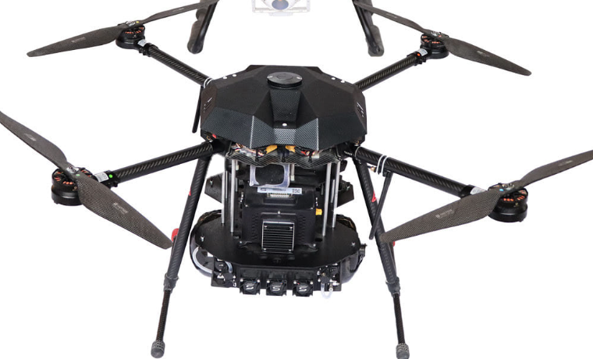
UAV COPTERS
SKILLS INCLUDES:
CONCEPTUALIZATION
COMPONENTS SELECTION
MATERIAL SELECTION
AVAILABILY IN THE MARKET
COMMUNICATION WITH THE SUPPLIERS
COST EFFICIENCY
3D MODELLING
AVIONICS PLACEMENT IN CAD
WEIGHT OPTIMIZATION
DFMA
BOM
3D PRINTING
2D DRAWING
FABRICATION
MANUAL ASSEMBLY (by hand)
MAKING OF PICTORIAL ASSEMBLY DOCUMENT FOR TECHNICIANS
GUIDING THE TECHNICIAN FOR PRODUCTION
PRODUCTION
QUAD-COPTER WITH FUEL-CELL PAYLOAD

Slide 9
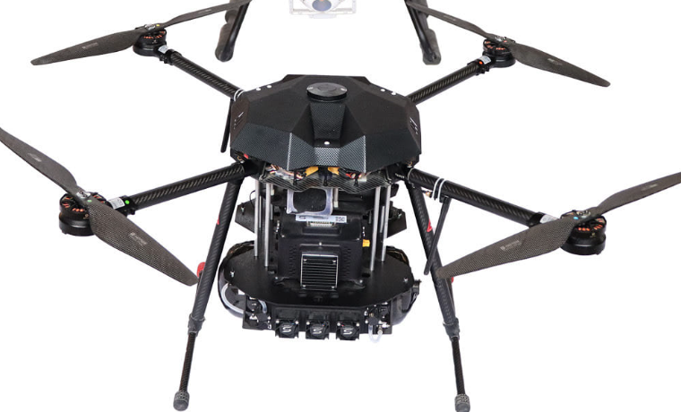
UAV COPTERS
CUSTOMIZED DESIGNED OF COPTER PLATES
CUSTOMIZED PAYLOAD ATTACHMENTS
CUSTOMIZED DESIGNED TO INCORPORATE:
-FUEL CELL CYCLINDER
-FUEL CELL POWER SUPPLY
-SPACERS
-MAKING SURE TO HAVE ENGOUGH SPACE FOR SEAMLESS INTERAGRATION OF AVIONICS
-ENOUGH AND PROPER SPACE FOR WIRING
-CUSTOMIZED DESIGN FOR ARMS HOLDERS
-CUSTOMIZED LANGING GEAR
QUAD-COPTER WITH FUEL-CELL

Slide 10
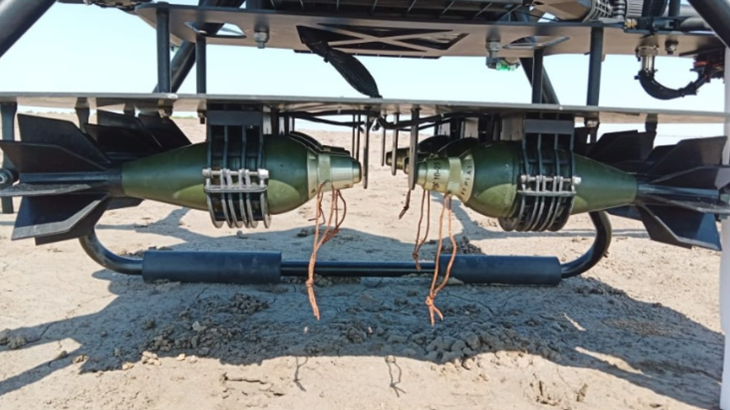
UAV COPTERS
CUSTOMIZED DESIGN OF COPTER PLATES
CUSTOMIZED PAYLOAD ATTACHMENTS
CUSTOMIZED DESIGN TO INCORPORATE:
-CUSTOM RELEASING MECHANISM FOR SHELLS
-ENGOUGH SPACE FOR SEAMLESS INTERAGRATION OF AVIONICS
-ENOUGH SPACE FOR WIRING
-CUSTOMIZED DESIGN FOR ARMS HOLDERS
-CUSTOMIZED LANGING GEAR HOLDERS
-CUSTOMIZED MOTOTR MOUNTS
-CUSTOMIZED ARM CLAMPERS
PAYLOAD RELEASING MECHANISM FOR MORTAR SHELLS

Slide 11
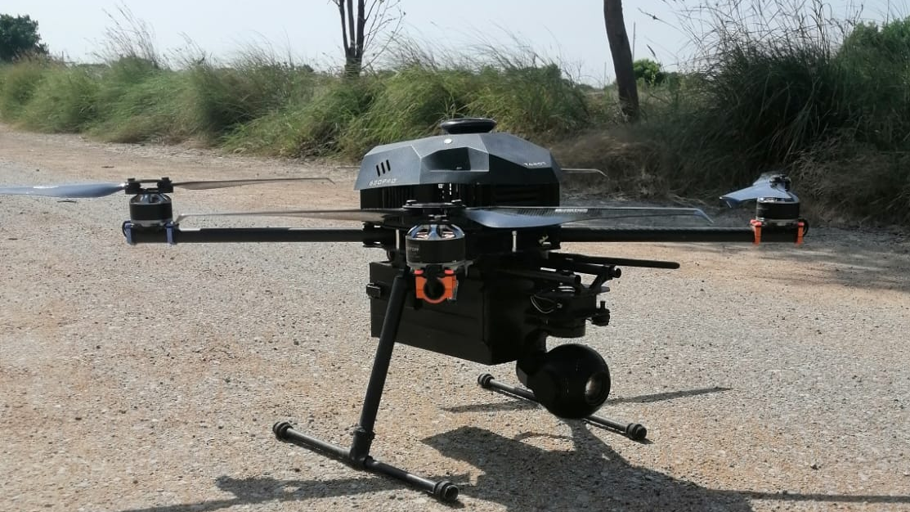
UAV COPTERS
CUSTOMIZED DESIGN OF COPTER PLATES
CUSTOMIZED PAYLOAD ATTACHMENTS
CUSTOMIZED DESIGN TO INCORPORATE:
-CUSTOM BATTERY HOUSING
-ENGOUGH SPACE FOR SEAMLESS INTERAGRATION OF AVIONICS
-ENOUGH SPACE FOR WIRING
-CUSTOMIZED DESIGN FOR ARMS HOLDERS
-CUSTOMIZED LANGING GEAR
-CUSTOMIZED MOTOTR MOUNTS
-CUSTOMIZED ARM CLAMPERS
-CUSTOMIZED DESIGN FOR GIMBAL CAMERA ATTACHMENT
QUAD-COPTER WITH BATTERY COMPARTMENT AND GIMBAL

Slide 12
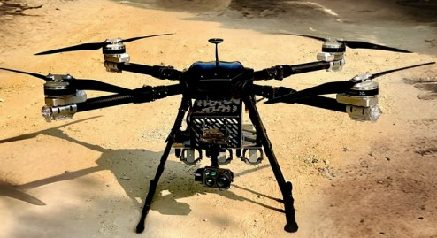
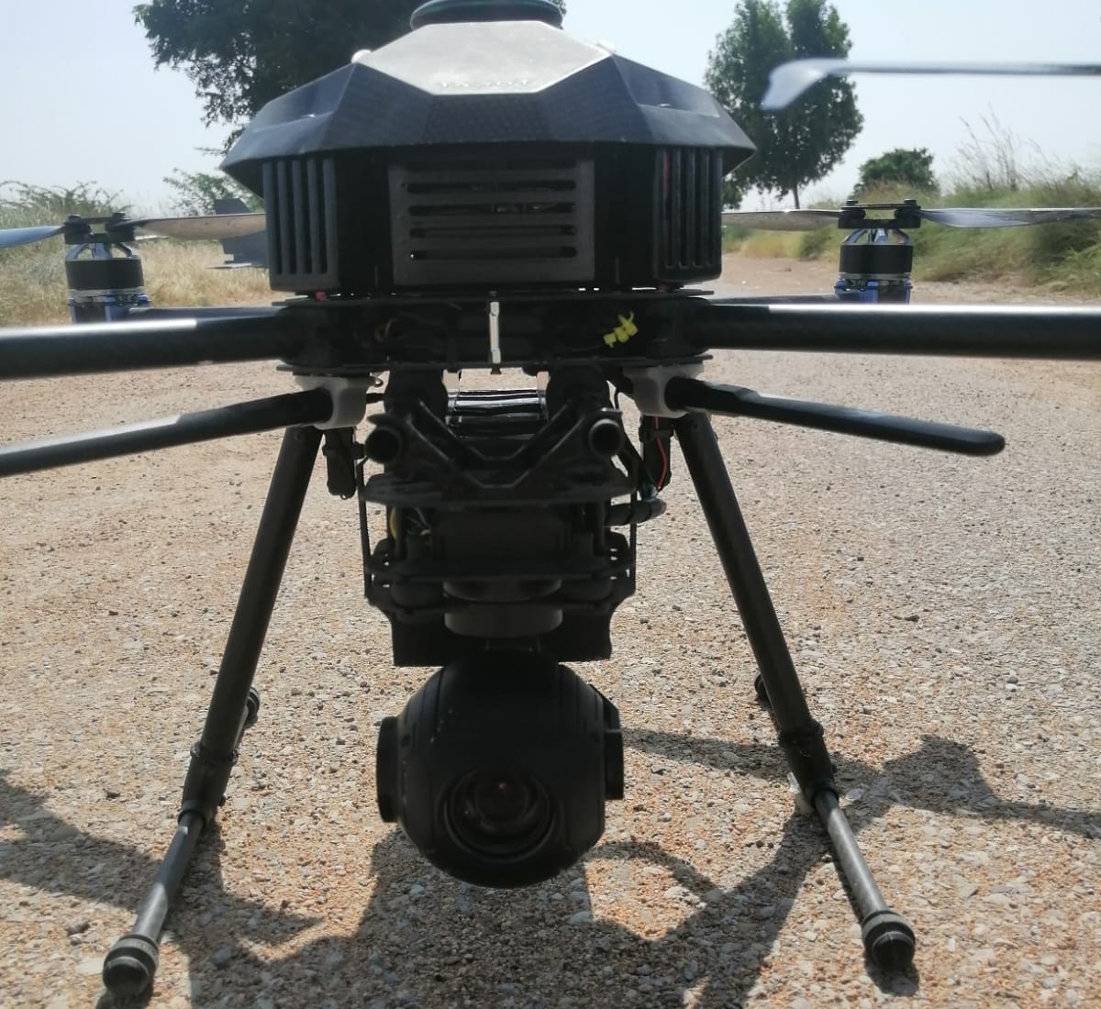
UAV COPTERS
QUAD-COPTER WITH HAVING PALOAD RELEASING MECHANISM
QUAD-COPTER WITH GIMBAL

Slide 13
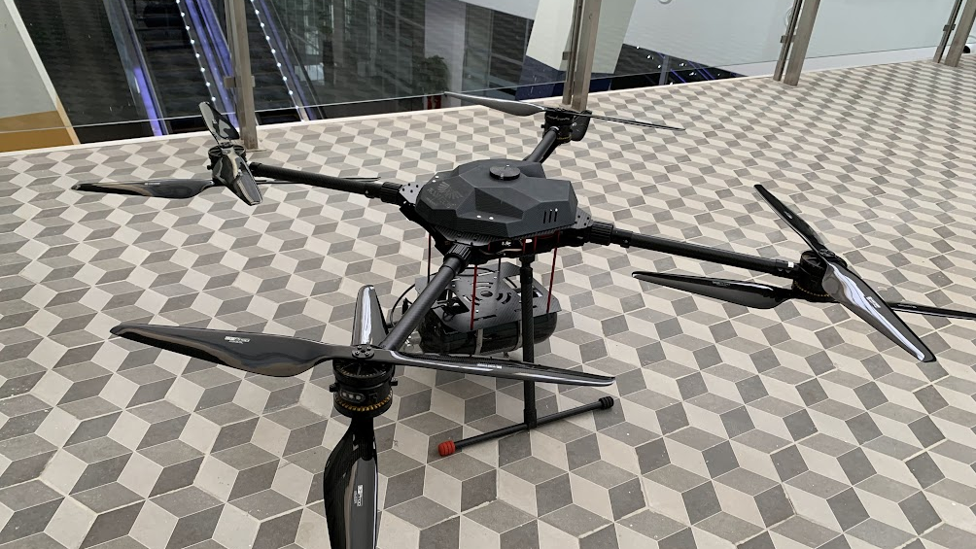
UAV COPTERS
COAXIAL COPTER CUSTOMIZED DESIGN TO INCORPORATE FUEL CELL AS A PAYLOAD

Slide 14
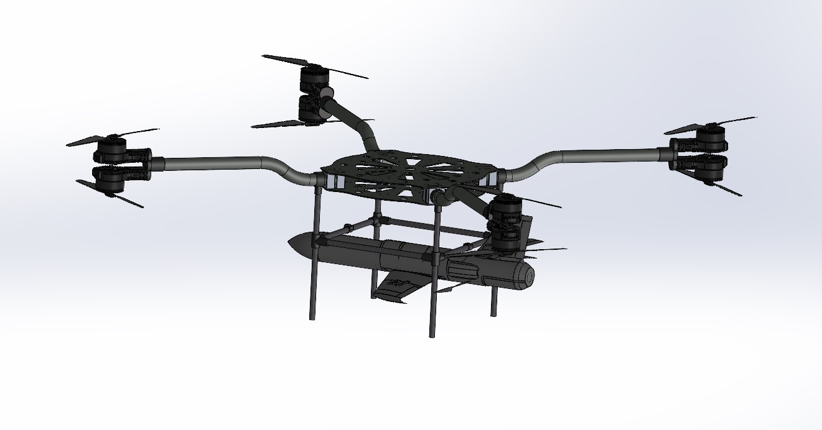
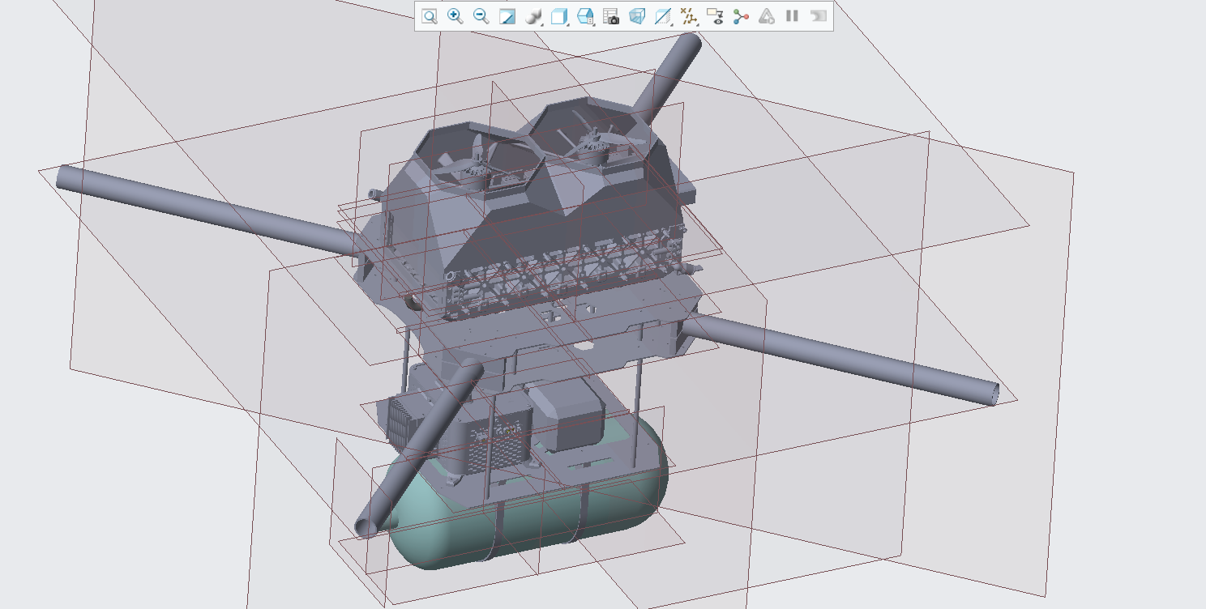
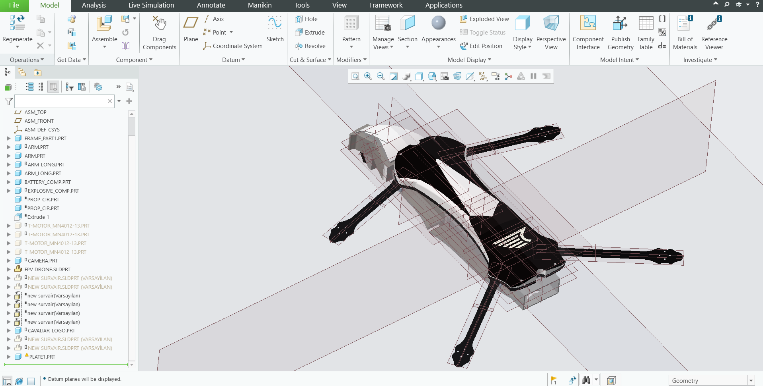
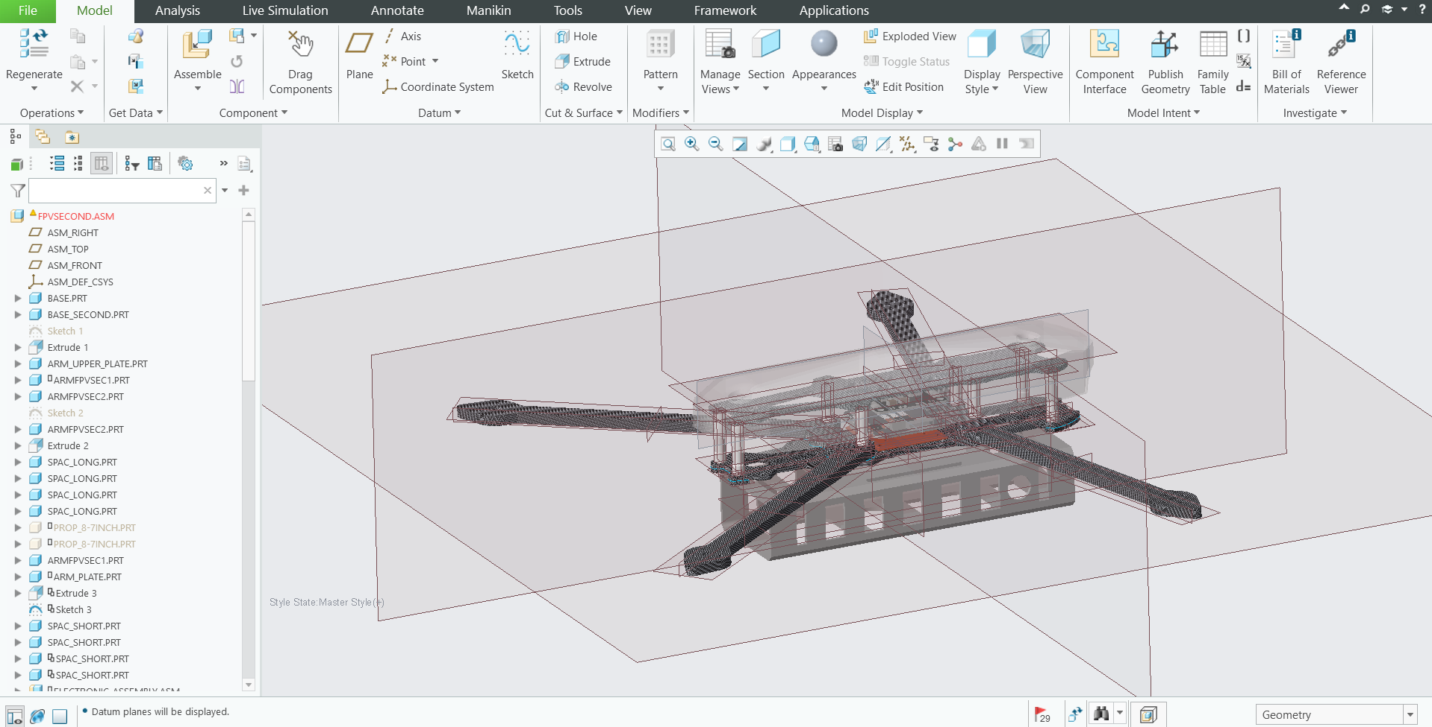
UAV COPTERS
A GLIMPSE OF CAD SCREENSHOTS

Slide 15
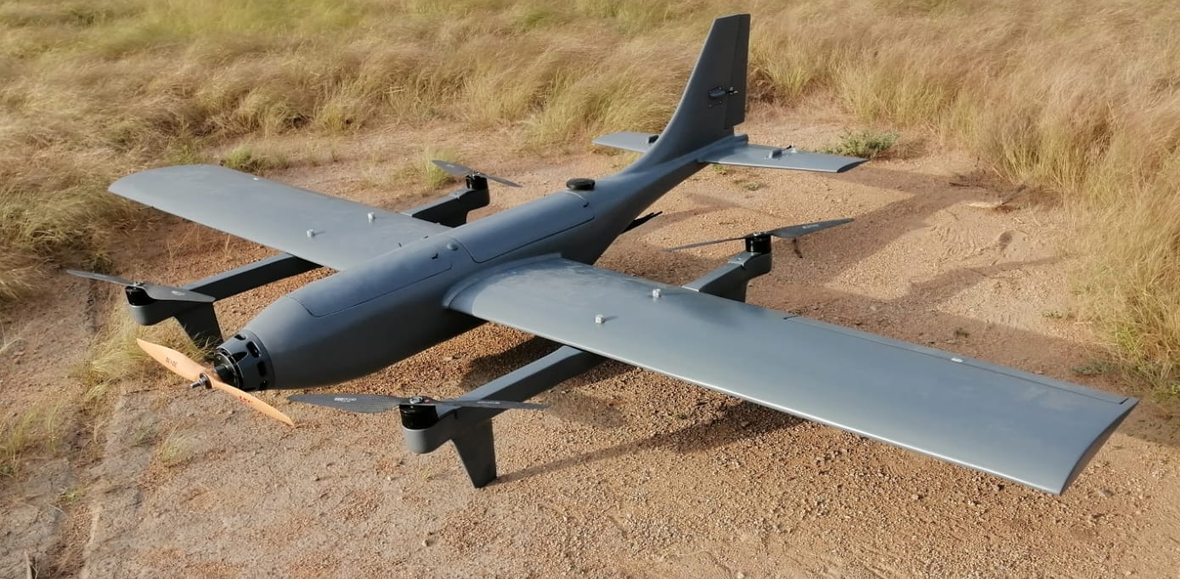
FIXED WING UAVs
SKILLS INCLUDES:
CONCEPTUALIZATION
UNDERSTANDING OF CLIENT REQUIREMENTS
COMPONENTS SELECTION
AVAILABILY IN THE MARKET
COMMUNICATION WITH THE SUPPLIERS
3D MODELLING OF OUTER BODY
3D MODELLING OF INTERNAL STRUCTURE
AVIONICS PLACEMENT IN THE CAD
WEIGHT OPTIMIZATION
DFMA
BOM
3D PRINTING
2D DRAWING
FABRICATION
MANUAL ASSEMBLY (by hand) INCLUDING INTERNAL STRUCTURE ASSEMBLY
MAKING OF PICTORIAL ASSEMBLY DOCUMENT FOR TECHNICIANS GUIDANCE
GUIDING TECHNICIANS
DEALING WITH ASSEMBLY ISSUE IF ARRISES (UNFORESEEN PROBLEMS)
PRODUCTION
FIXED WING VTOL UAV

Slide 16
FIXED WING UAVs
MODELLED FIXED WING OUTER BODY + WINGS + TAILS
MODELLED INTERNAL STRUCTURE
CUSTOMIZED INTERNAL STRUCTURE INCLUDES
-ENOUGH TOLERANCE BETWEEN SKIN AND STRUCTURE FOR SEAMLESS PLACEMENT AND BOND IN MOLD
-PLACEMENT OF AVIONICS ON DESIRED SPOT
-ENOUGH SPACE FOR HAND OR TOOLS FOR MANUAL ASSEMBLY
-ENOUGH SPACE FOR WIRING
-SERVO HOUSING IN THE WING / TAIL TO FIT FOR CONTROL SURFACES
- MOTOR MOUNTS
- HATCHES
FIXED WING UAV (VTOL)

Slide 17
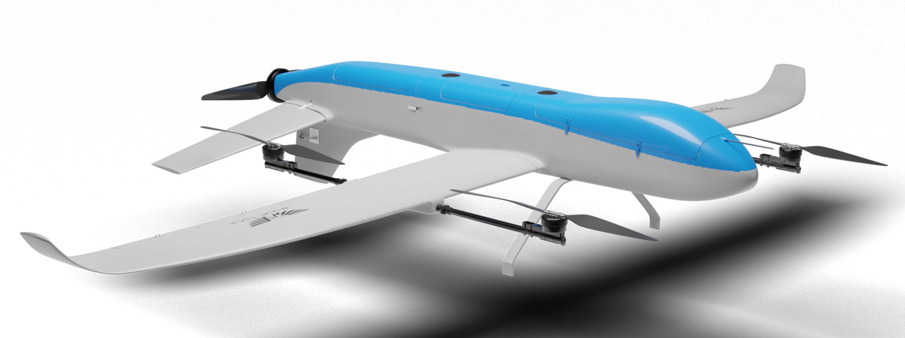
FIXED WING UAVs
MODELLED FIXED WING OUTER BODY + WINGS + TAILS
MODELLED INTERNAL STRUCTURE
CUSTOMIZED INTERNAL STRUCTURE INCLUDES
-ENOUGH TOLERANCE BETWEEN SKIN AND STRUCTURE FOR SEAMLESS PLACEMENT AND BOND IN MOLD
-PLACEMENT OF AVIONICS ON DESIRED SPOT
-ENOUGH SPACE FOR HAND OR TOOLS FOR MANUAL ASSEMBLY
-ENOUGH SPACE FOR WIRING
-SERVO HOUSING IN THE WING / TAIL TO FIT FOR CONTROL SURFACES
- MOTOR MOUNTS
- HATCHES
FIXED WING UAV (VTOL)

Slide 18
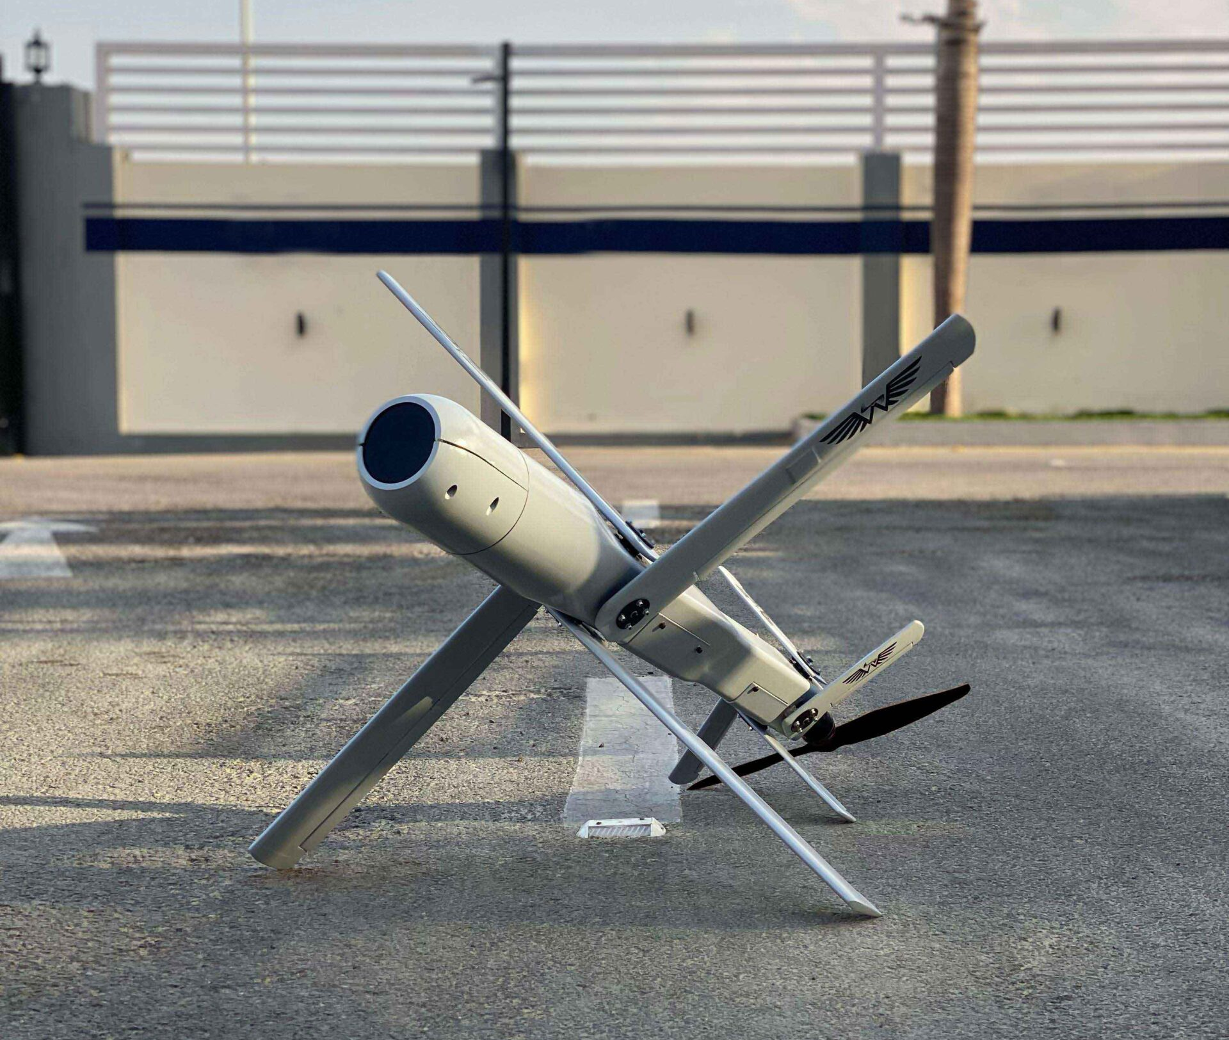
LOITER MUNITION UAVs
MODELLED OUTER BODY + WINGS + TAILS
MODELLED INTERNAL STRUCTURE
EXTENSIVELY WORKED ON FOLDING MECHANISM
CUSTOMIZED INTERNAL STRUCTURE INCLUDES
-ENOUGH TOLERANCE BETWEEN SKIN AND STRUCTURE FOR SEAMLESS PLACEMENT AND BOND IN MOLD
-PLACEMENT OF AVIONICS ON DESIRED SPOT
-ENOUGH SPACE FOR HAND OR TOOLS FOR MANUAL ASSEMBLY
-ENOUGH SPACE FOR WIRING
-SERVO HOUSING IN THE WING / TAIL TO FIT FOR CONTROL SURFACES
-MOTOR MOUNT
LOITER MUNITION UAV
DOUBLE FOLDING MECHANISM FOR WINGS + TAILS

Slide 19
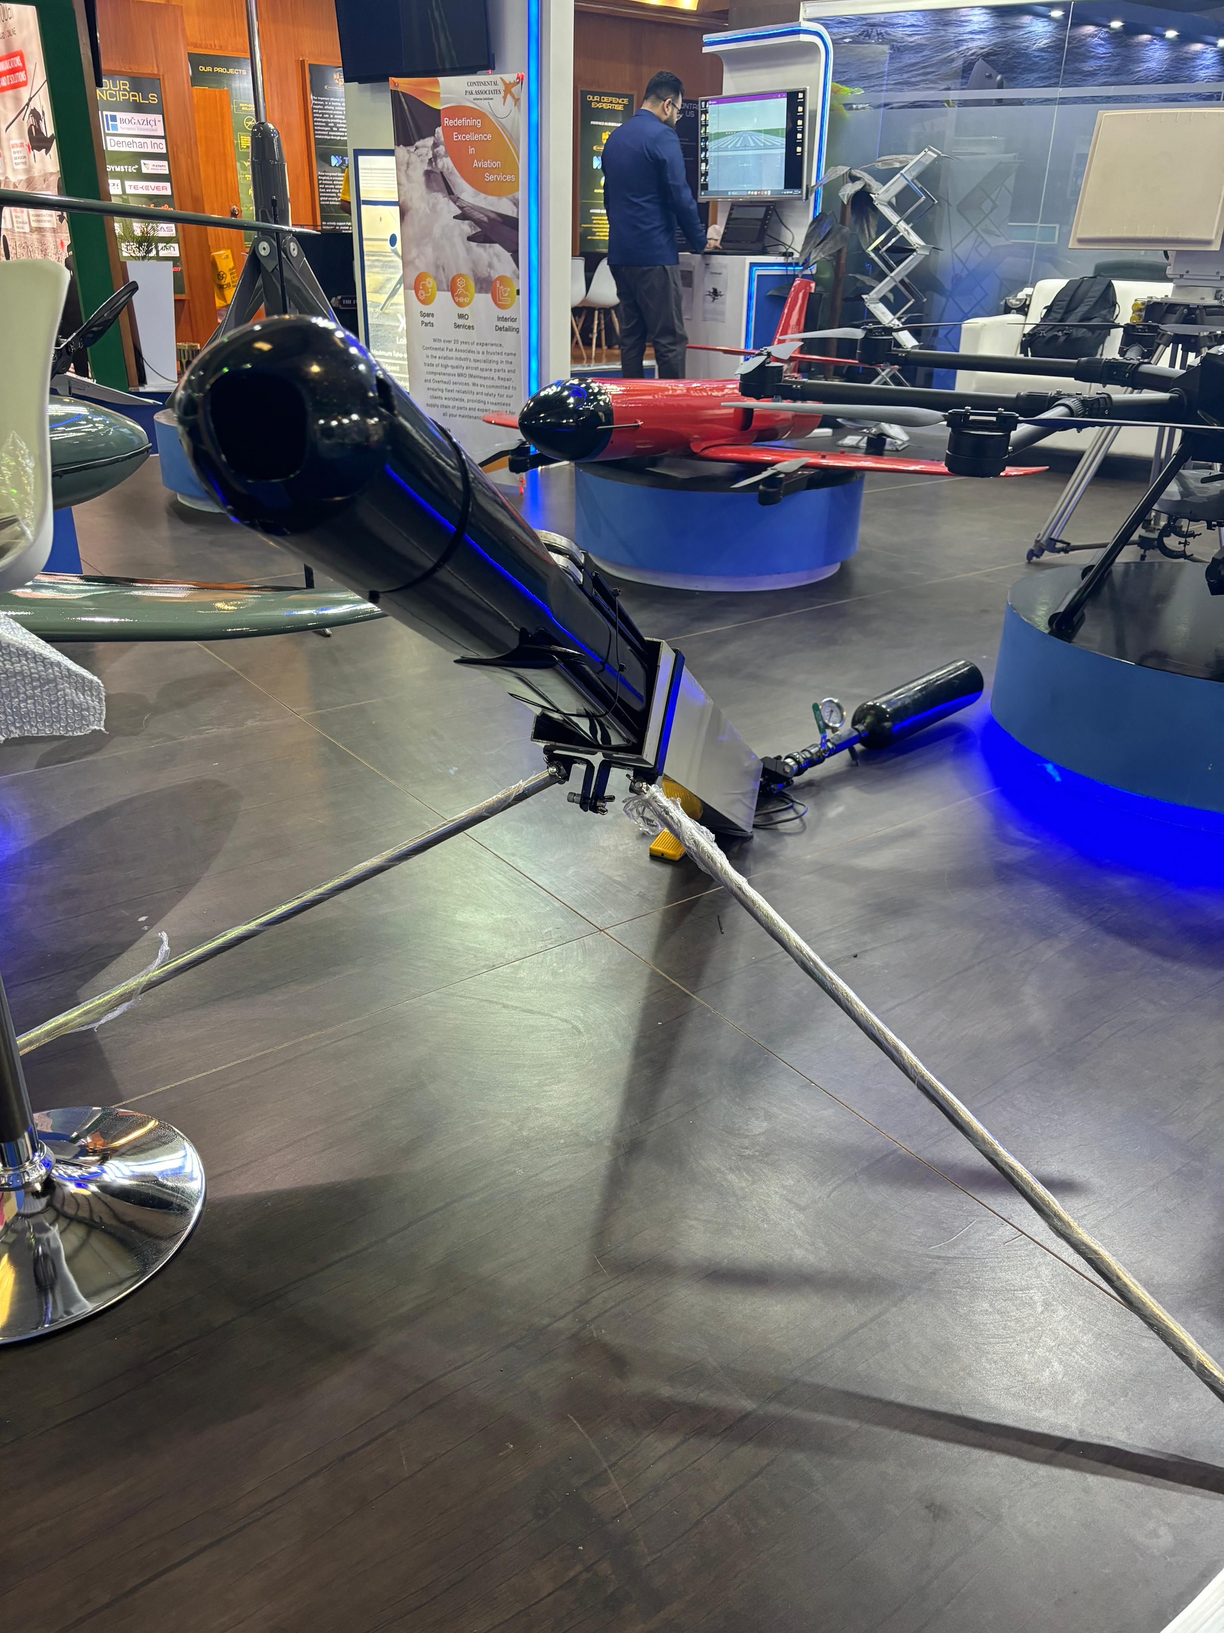
LOITER MUNITION UAVs
MODELLED OUTER BODY + WINGS + TAILS
MODELLED INTERNAL STRUCTURE
EXTENSIVELY WORKED ON FOLDING MECHANISM
DESIGNED AND MODELLED PNEUMATIC TUBE LAUNCHER
FOLDABLE LOITER MUNITION UAV IN PNEUMATIC TUBE LAUNCHER

Slide 20
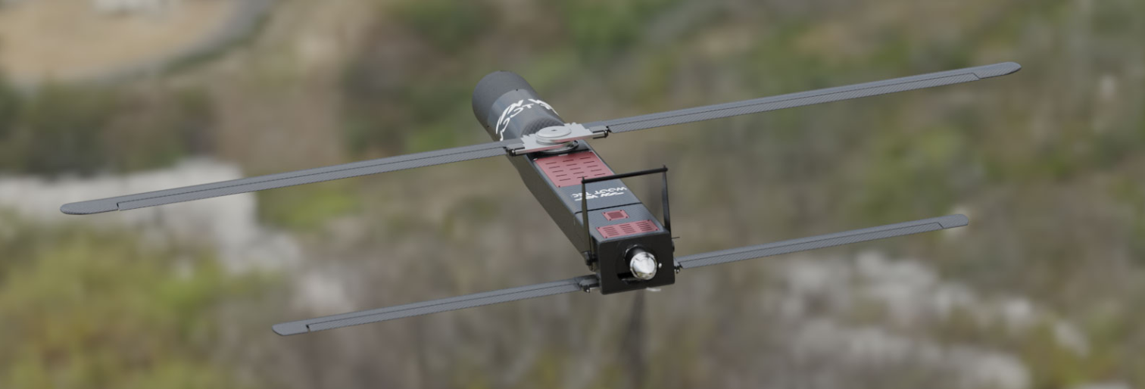
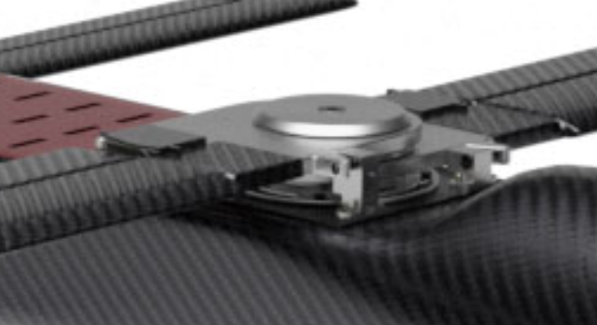
LOITER MUNITION UAVs
DOUBLE FOLDABLE LOITER MUNITION UAV
MODELLED OUTER BODY
MODELLED INTERNAL STRUCTURE
EXTENSIVELY WORKED ON DOUBLE FOLDING MECHANISM
DESIGNED FOLDING MECHANISM FOR STABILIZERS
FOLDABLE STABILIZERS
DOUBLE FOLDING MECHANISM FOR WINGS + TAILS

Slide 21
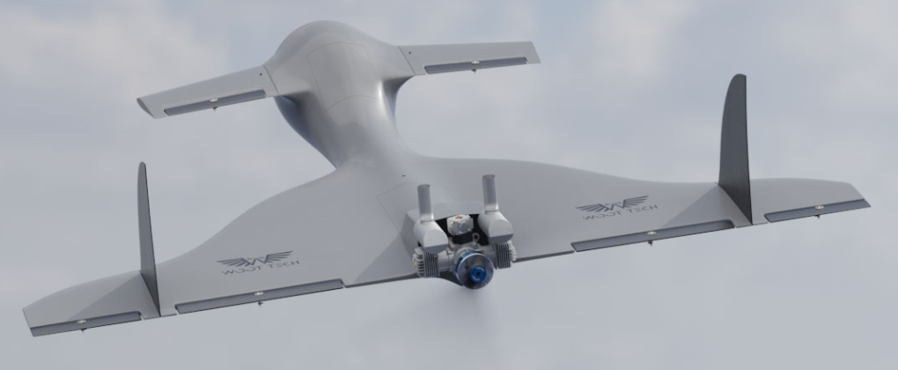
LOITER MUNITION FIXED-WING UAV
FULLY DESIGNED AND MODELLED
MODELLED RIGID MOTOR MOUNTS
CUSTOMIZED INTERNAL STRUCTURE INCLUDES
-ENOUGH TOLERANCE BETWEEN SKIN AND STRUCTURE FOR SEAMLESS PLACEMENT AND BOND IN MOLD
-PLACEMENT OF AVIONICS ON DESIRED SPOT
-ENOUGH SPACE FOR HAND OR TOOLS FOR MANUAL ASSEMBLY
-ENOUGH SPACE FOR WIRING
-SERVO HOUSING IN THE WING / TAIL TO FIT FOR CONTROL SURFACES
- RIGID MOTOR MOUNT TO WITHSTAND MOTOR POWER
- HATCHES
FIXED WING UAV LOITER MUNITION UAV

Slide 22
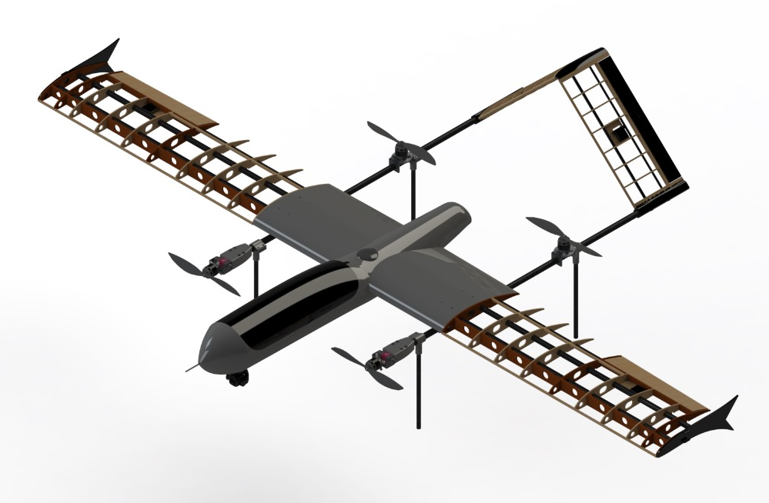
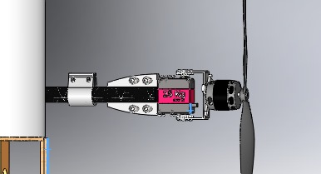
CAD GLIMPSE OF FIXED WING UAVs
UAV PICTORIAL VIEW OF CAD

Slide 23
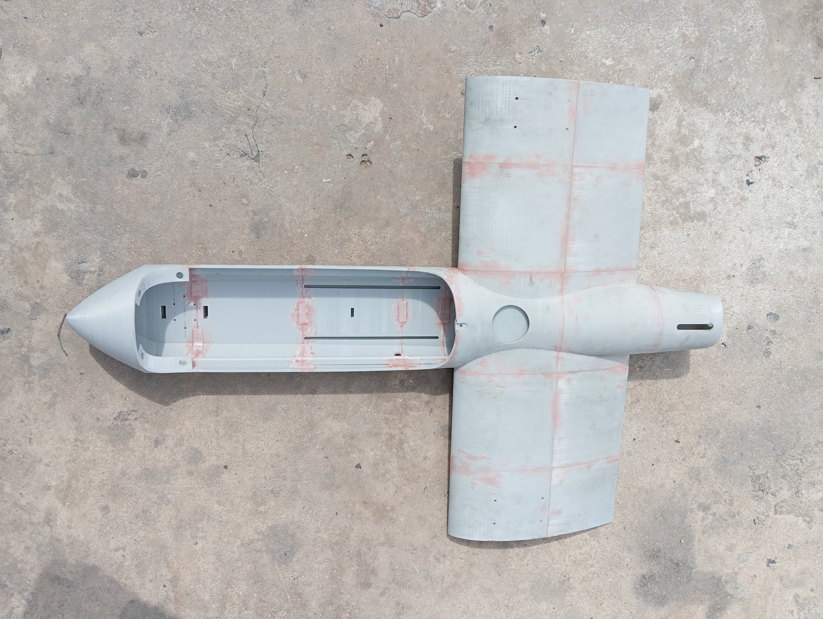
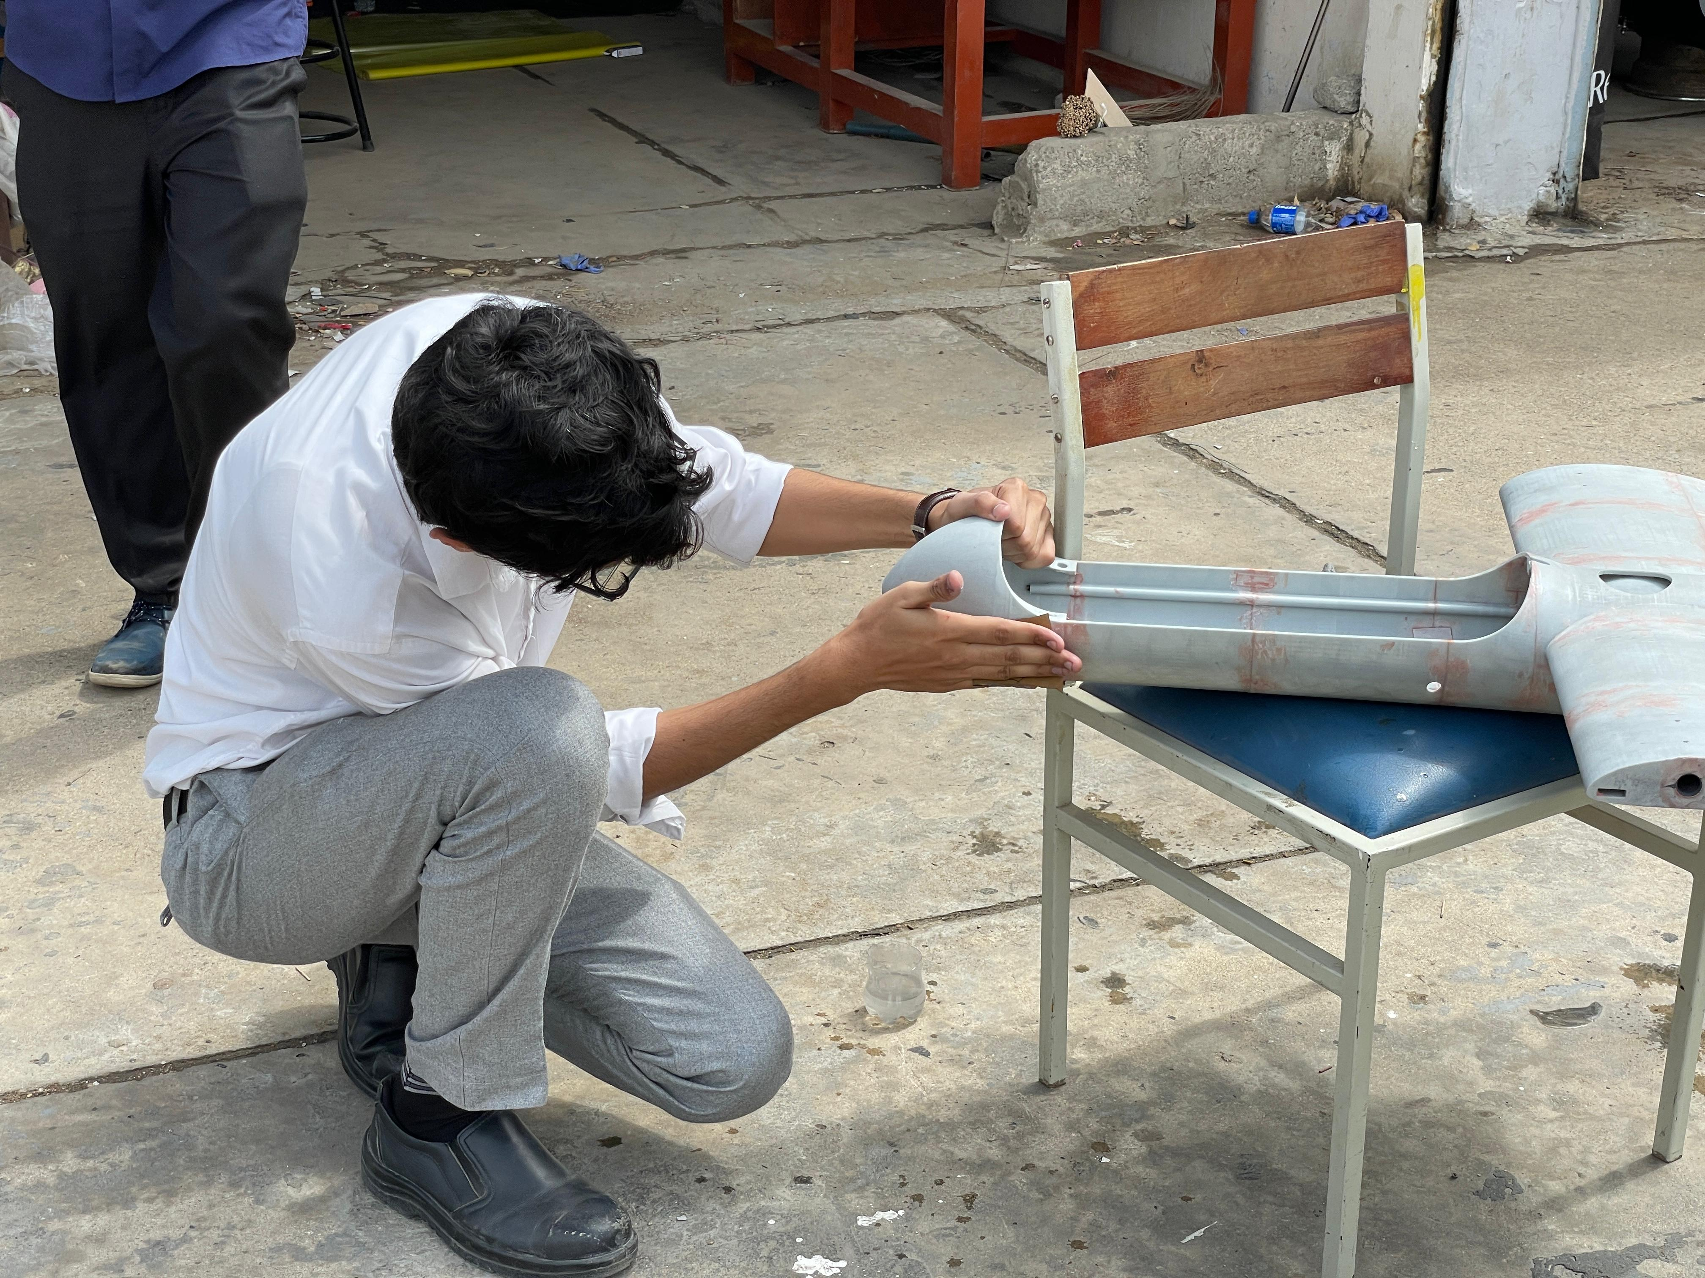
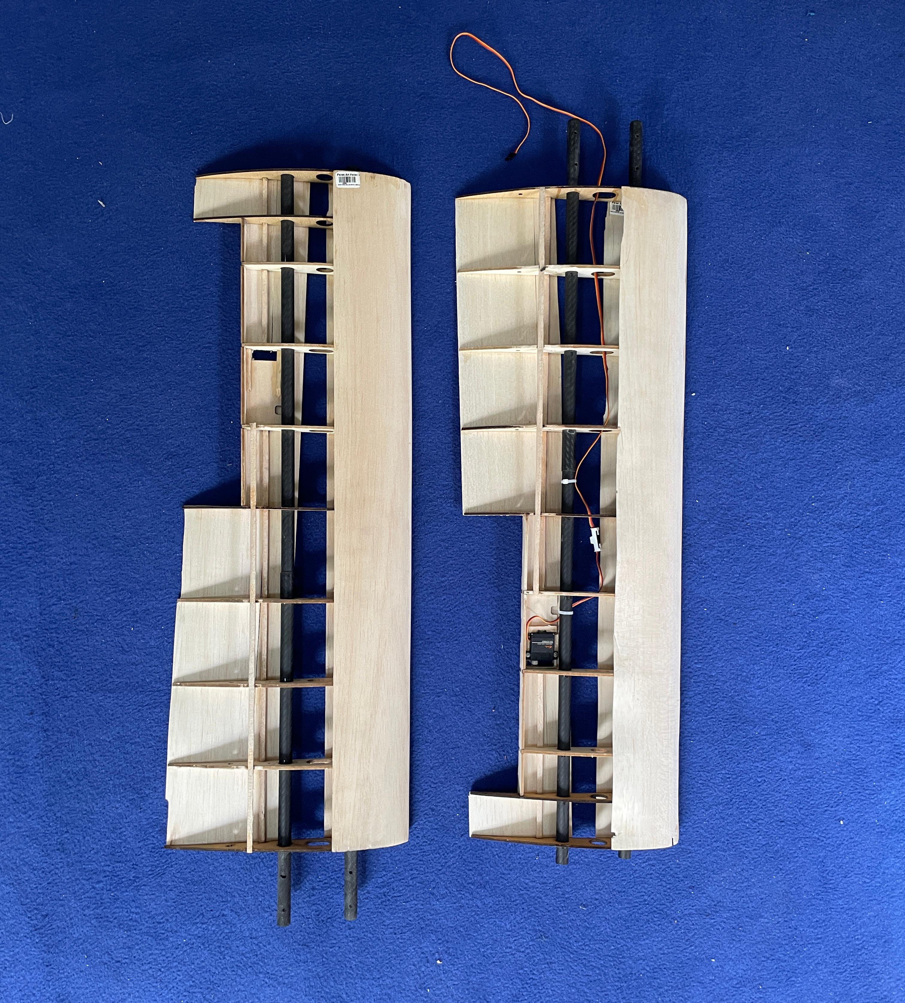
FIXED WING UAVs
OVERVIEW OF UAV IN 3D PRINTED SPLITED PARTS ASSEMBLED TOGETHER (FIRST 2 PICTURES) AND A VIEW OF INTERNAL STRUCTURE OF WING HAVING SERVO AND SPARS ASSEMBLED (3RD PICTURE)

Slide 24
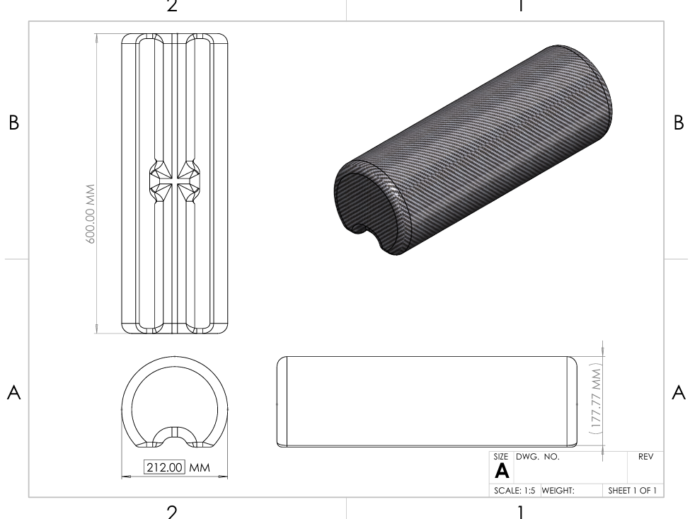
2D DRAWINGS
CREATED PART / ASSEMBLY DRAWINGS FOR SEAMLESS PRODUCTION
CREATED 2D DRAWINGS (DXF) FOR MACHINING (CNC LASER + CNC ROUTER)
CREATED 2D DRAWINGS FOR LOCAL AND CHINEESE MANUFACTURERS
CREATED 2D DRAWINGS FOR TECHNICIANS FOR SEAMLESS PRODUCTION
PART DRAWING

Slide 25
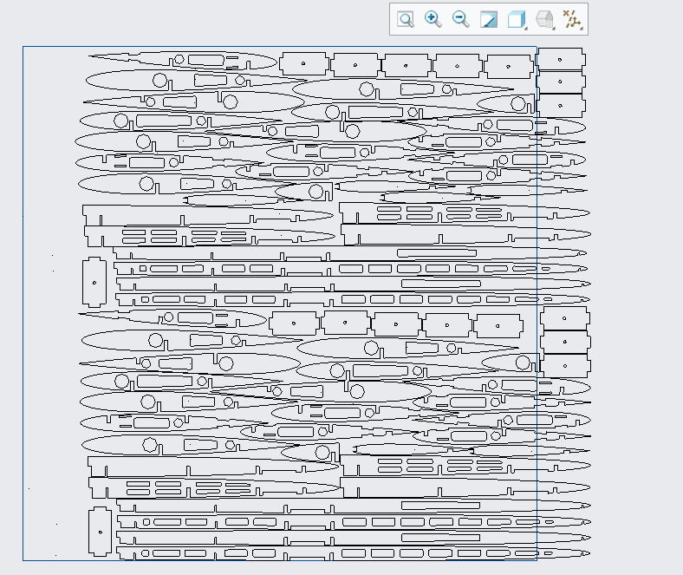
2D DRAWINGS
VECTOR DRAWING/2D DRAWINGS FOR CNC LASER CUTTING

Slide 26
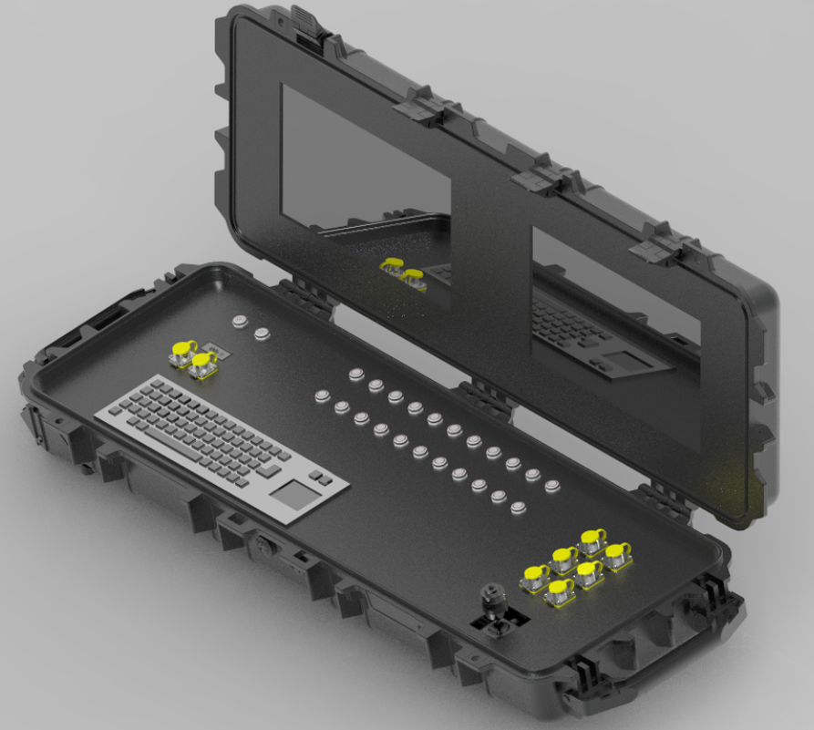
GROUND CONTROL STATION
SKILLS INCLUDES:
CONCEPTUALIZATION
UNDERSTANDING OF CLIENT REQUIREMENTS
COMPONENTS SELECTION
AVAILABILY IN THE MARKET
COMMUNICATION WITH THE SUPPLIERS
AVIONICS PLACEMENT IN THE CAD
DFMA
BOM
3D PRINTING
2D DRAWING FOR PLATE
FABRICATION
MANUAL ASSEMBLY
DEALING WITH ASSEMBLY ISSUE IF ARRISES
PRODUCTION
GROUND CONTROL STATION (CAD)

Slide 27
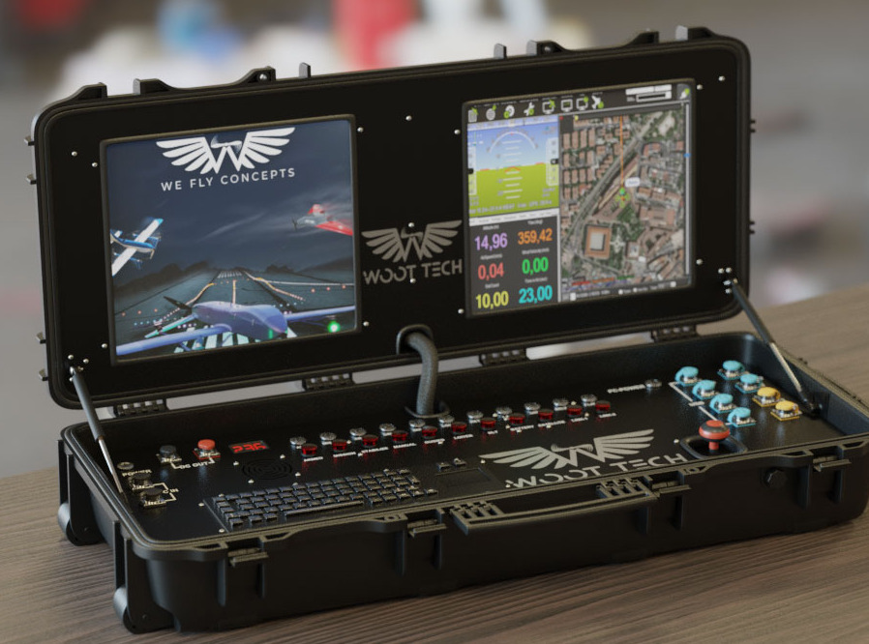
GROUND CONTROL STATION
GROUND CONTROL STATION

Slide 28
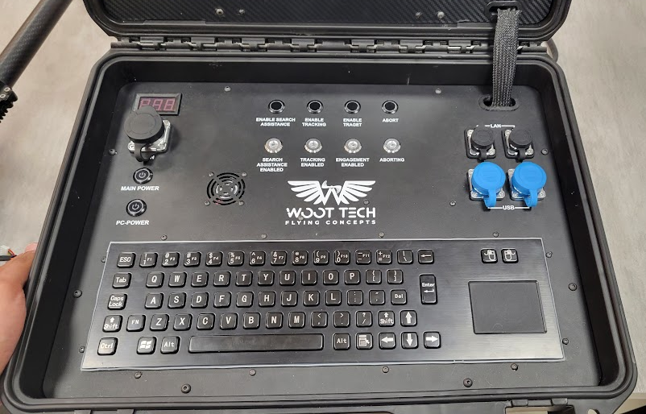
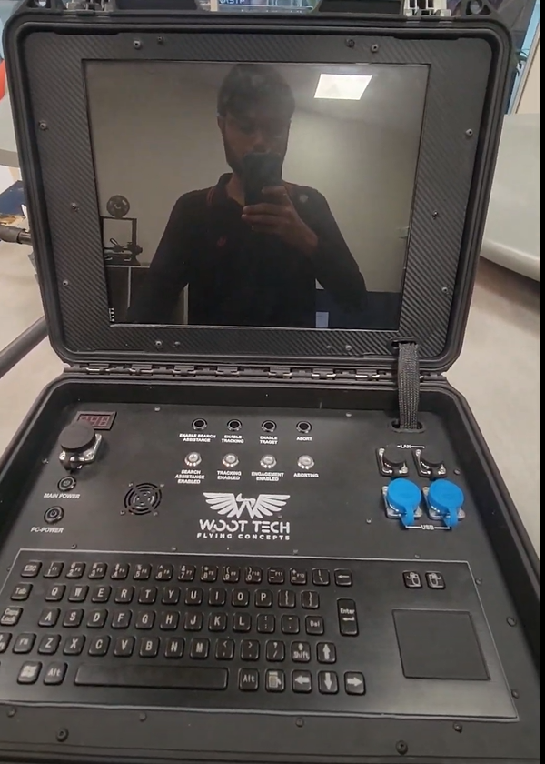
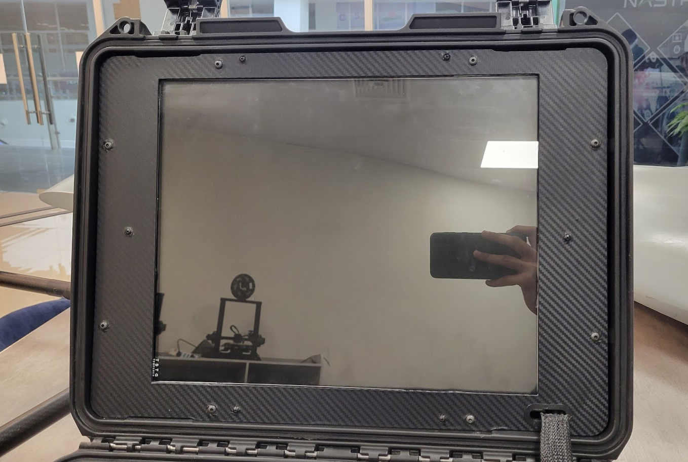
GROUND CONTROL STATION
GROUND CONTROL STATION

Slide 29
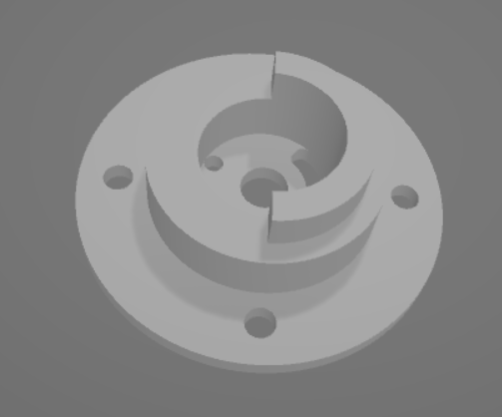
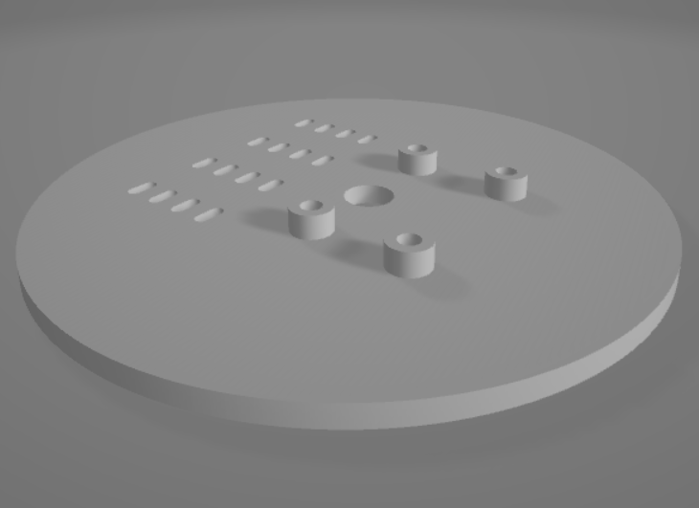
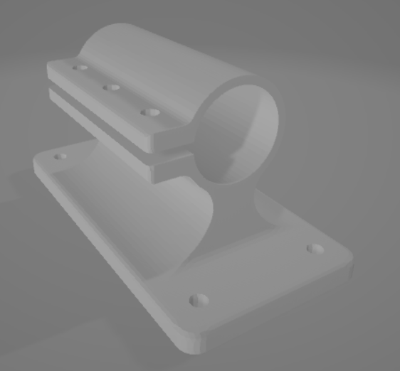
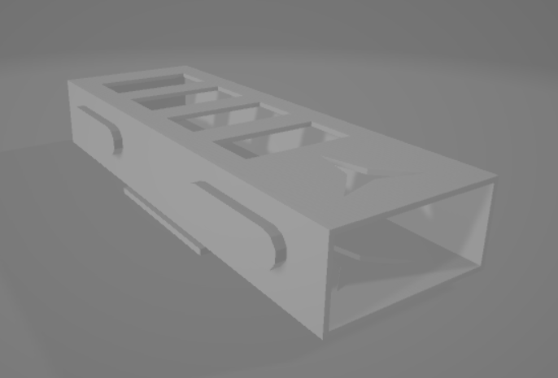
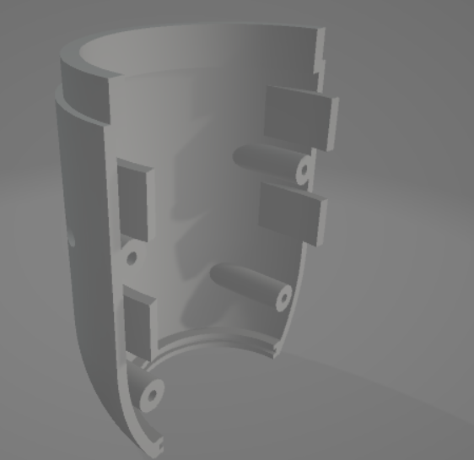
3D PARTS

Slide 30
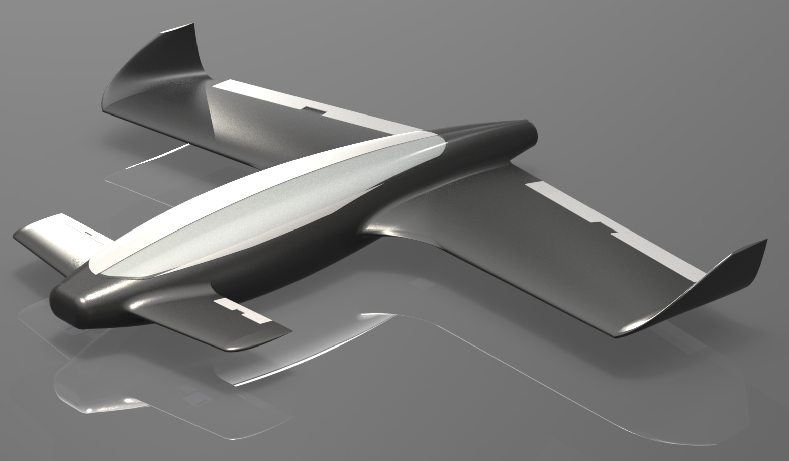
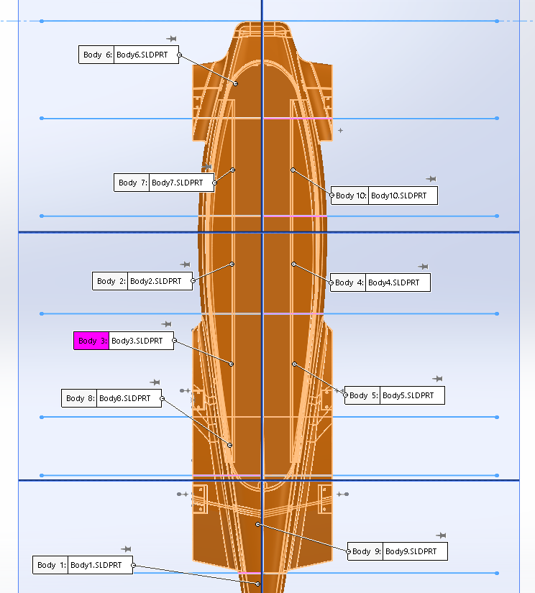
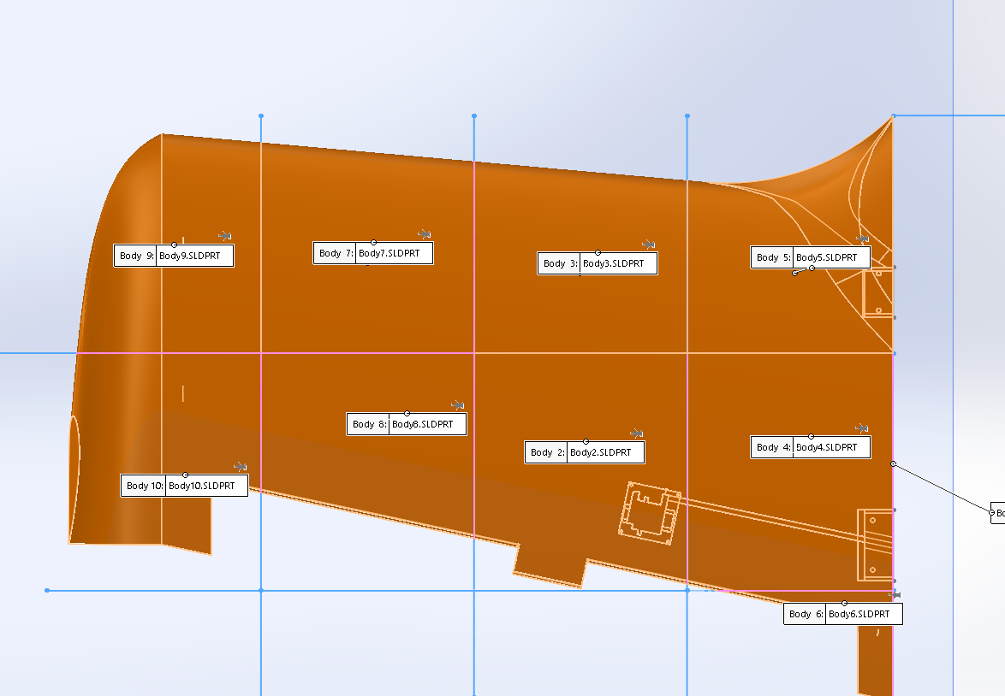
3D PRINTING

Slide 31
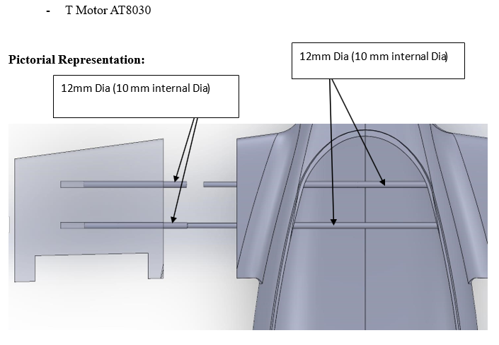
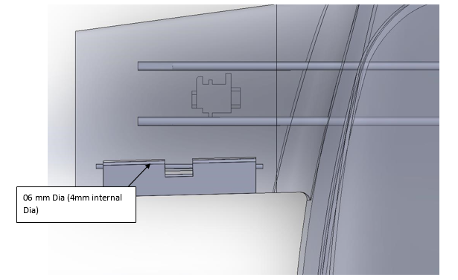
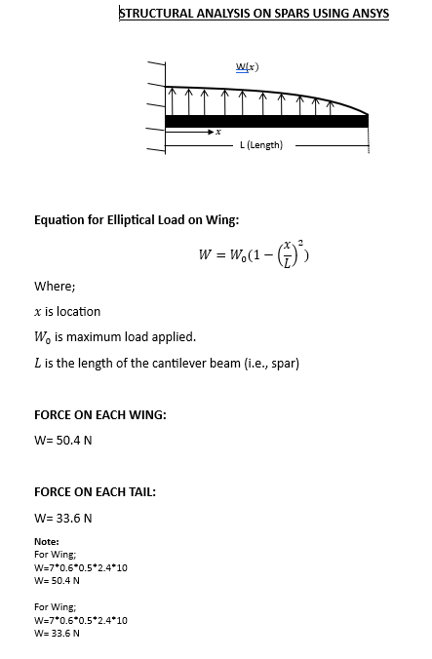
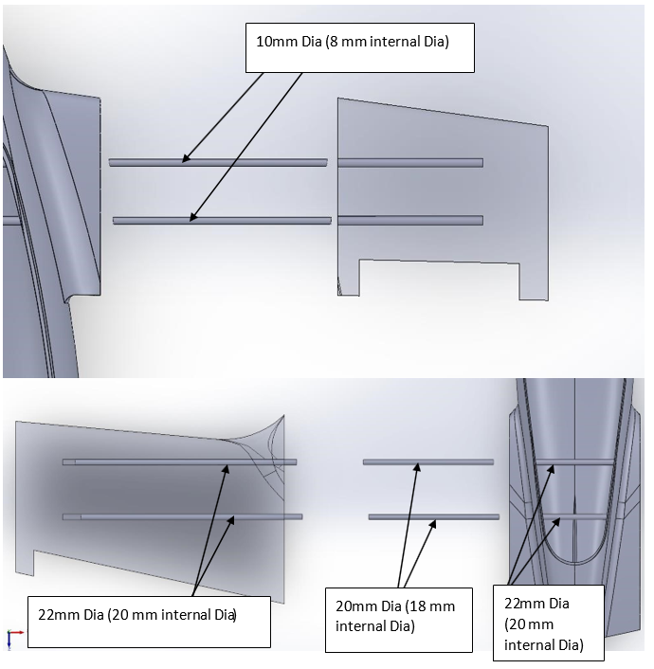
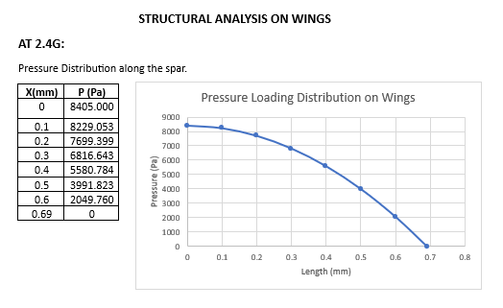
TECHNICAL DOCUMENTATION

Slide 32
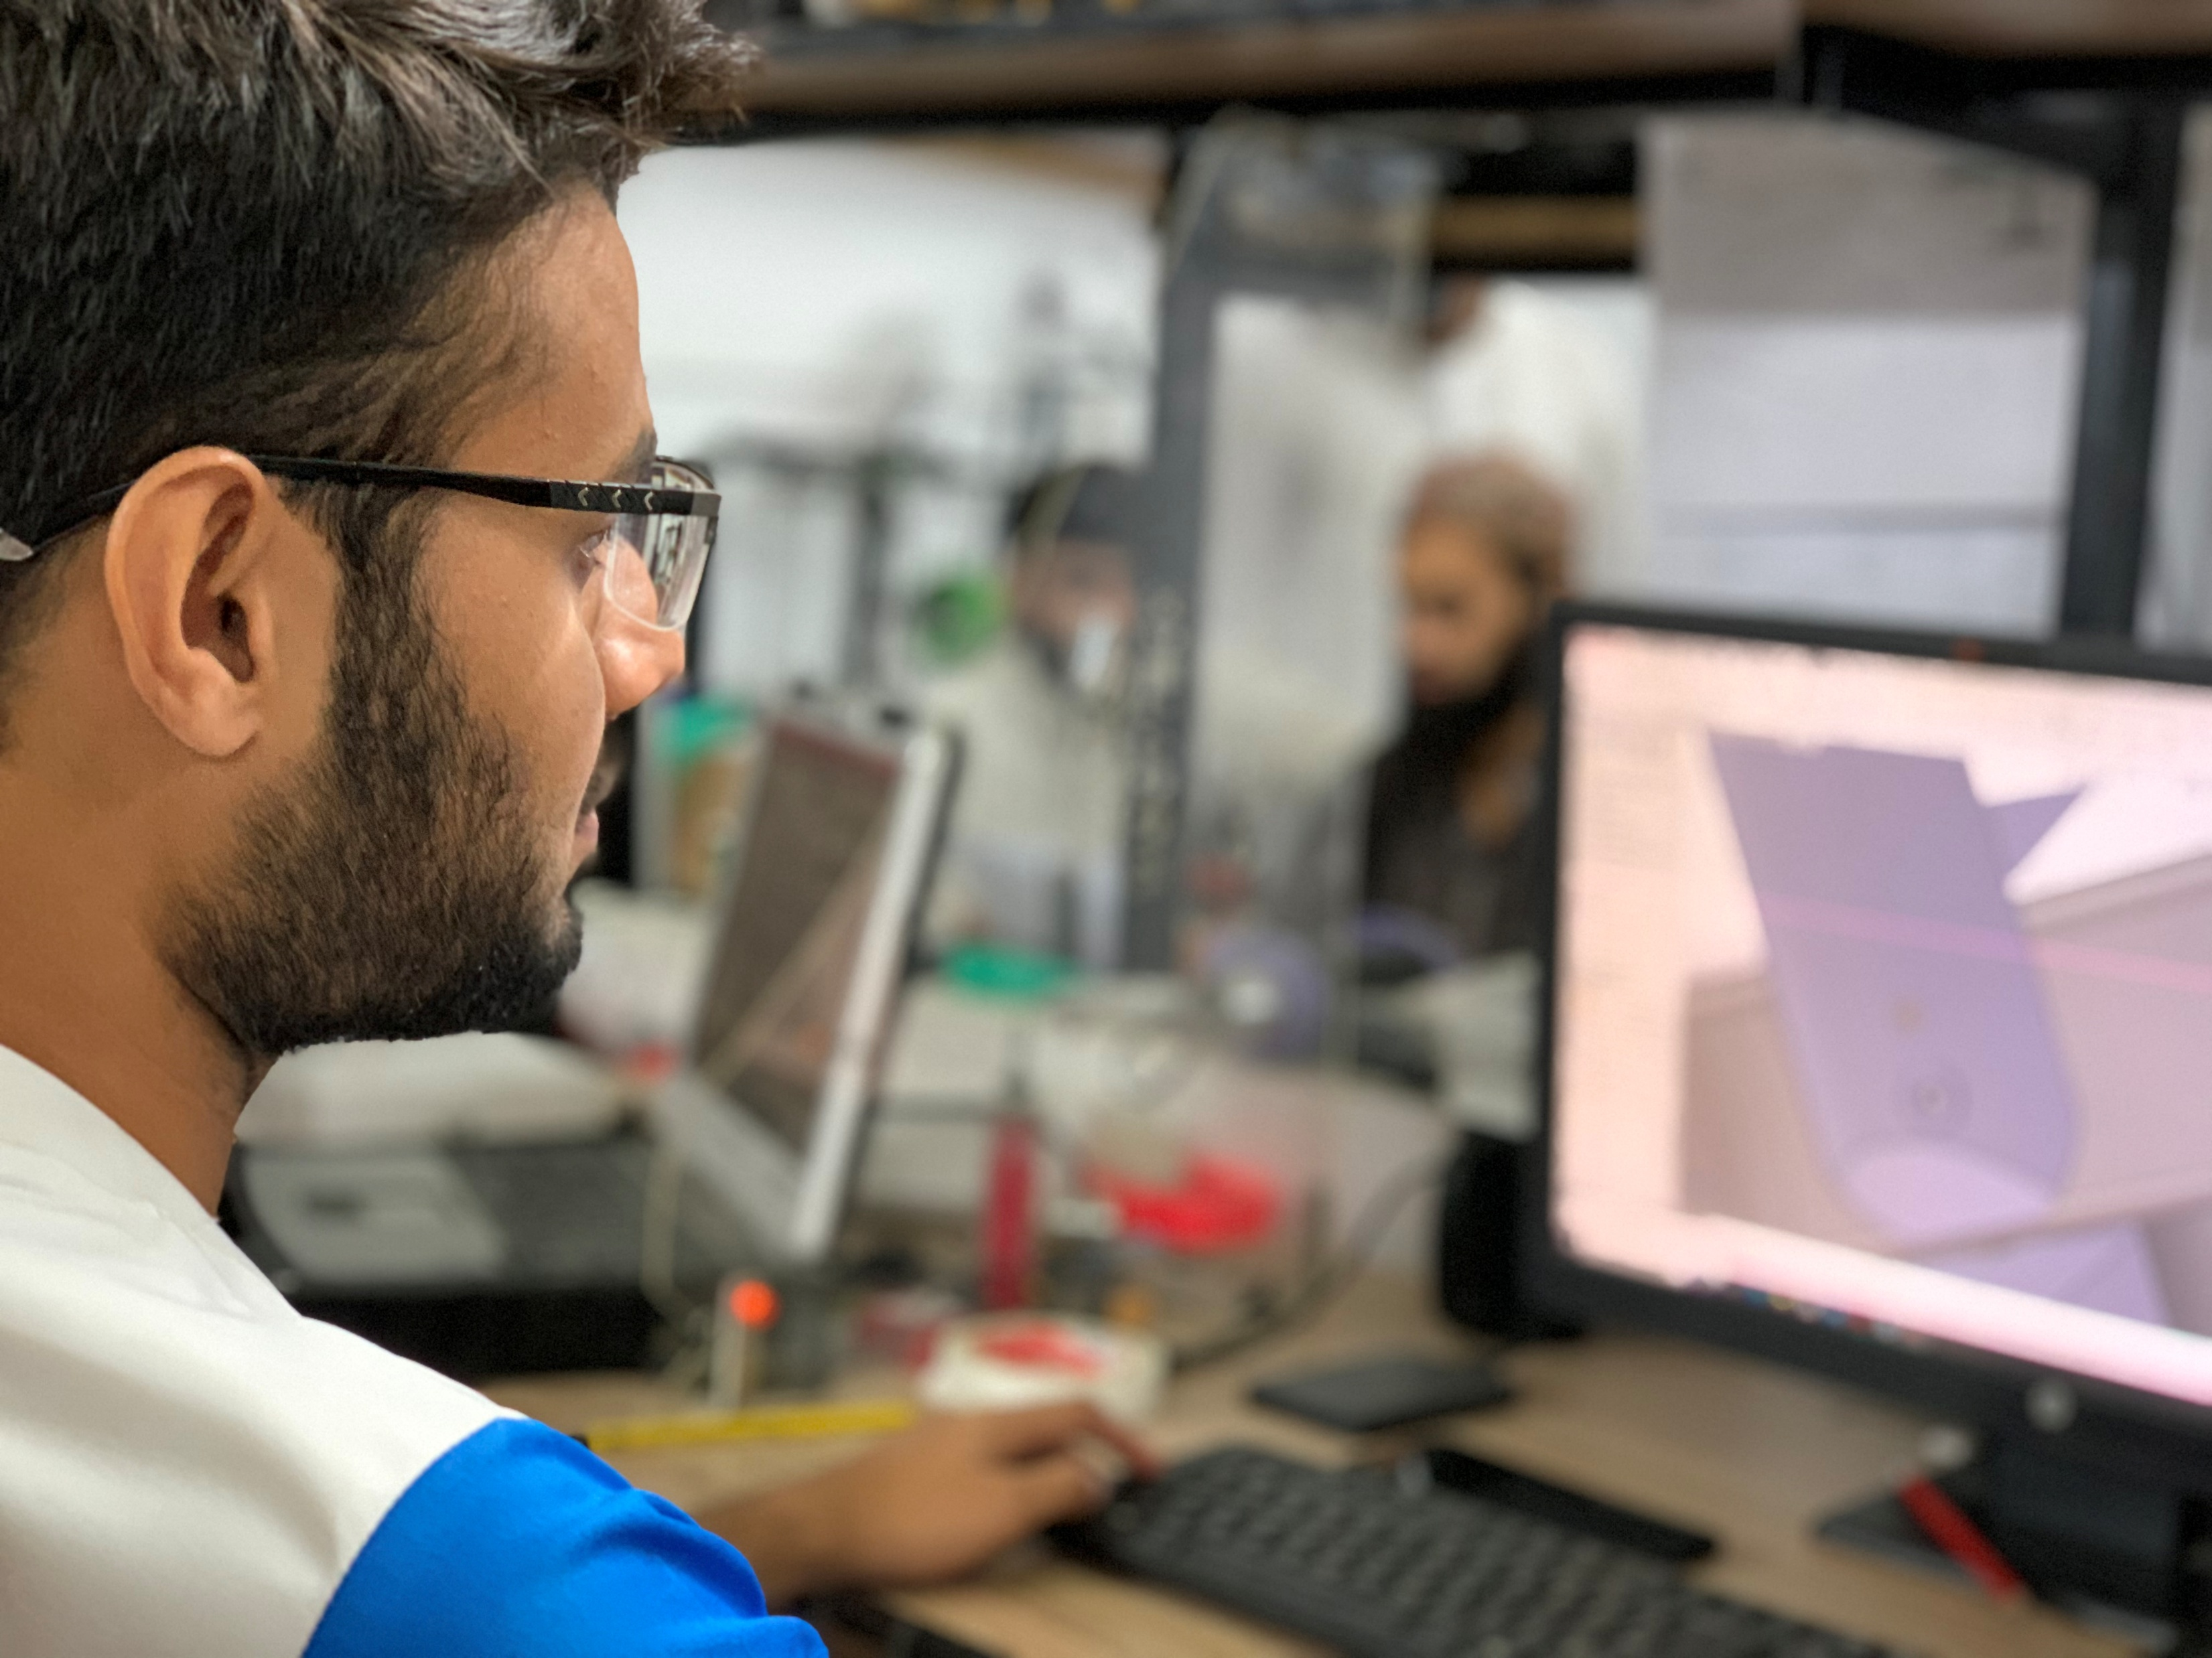
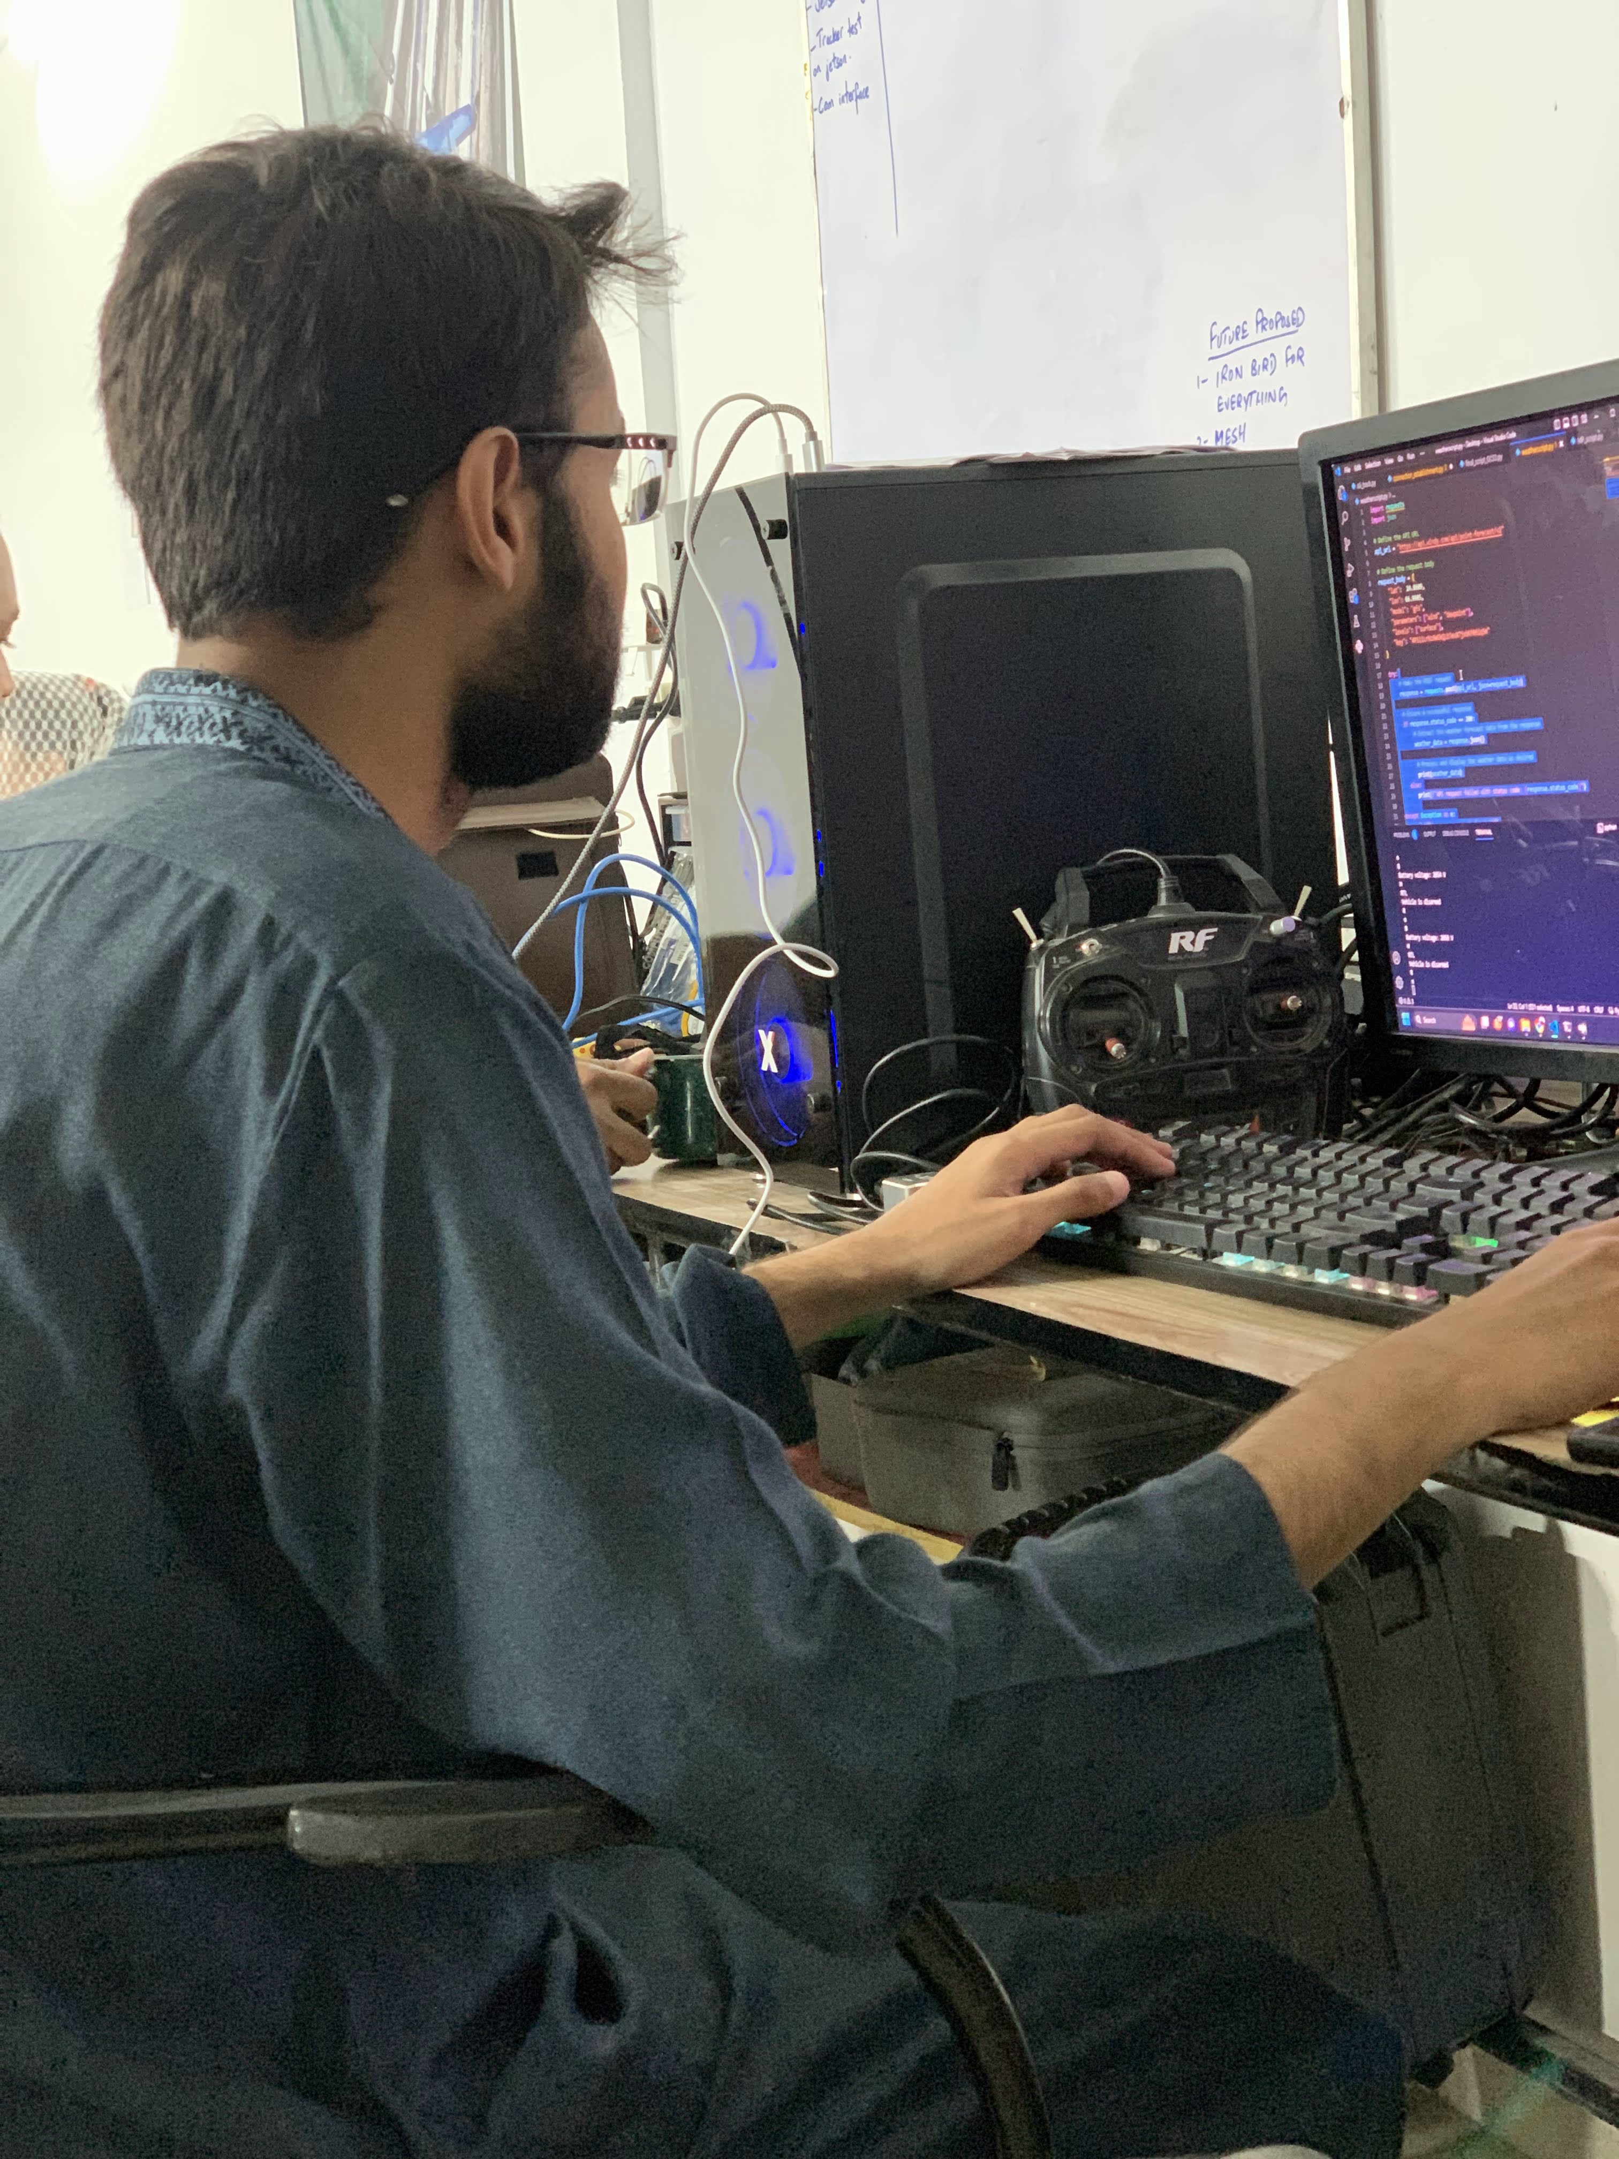
THANK YOU

